Slide 1
Basic Java
Unit 3 – OO in Java

Slide 2
Topics
What is OOP?
OOP v/s Structured Programming
Classes & Objects
Access Specifiers
Constructors
Static Members
Encapsulation
Abstraction
Inheritance
Polymorphism
Final modifier
Inner Classes

Slide 3
The procedural approach
The procedural approach
  Deals with functions as the building blocks
  Easy to start with
  Higher comfort level for a new programmer
Simple decomposition technique for
  Modularity
  Reusability
  Complexity
  Functions are the building blocks
  Top – down decomposition

Slide 4
OO Approach
An Object oriented approach views systems and programs as a collection of interacting objects.
An object is a thing in a computer system that is capable of responding to messages
OBJECT
OBJECT
Do this
Do this
OBJECT
OBJECT
OBJECT
Do this
OBJECT

Slide 5

What are Objects?
We interact with objects everyday
  A customer
  An order
An object represents an entity – physical, conceptual or software
  Physical entity
    Employee, Customer, Supplier
  Conceptual entity
    Sales, Policy, TaxCalculator
  Software entity
    Linked List, Connection, etc.
A programmer should make a good effort to capture the conceptual entities in addition to physical entities which are relatively straight forward to identify
  Your car
  The telephone

Slide 6
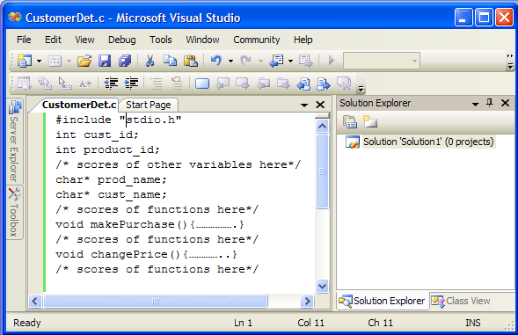
Why choose the OO approach?
Can you identify
where is Customer ?
Can you identify
where is Product ?

Slide 7
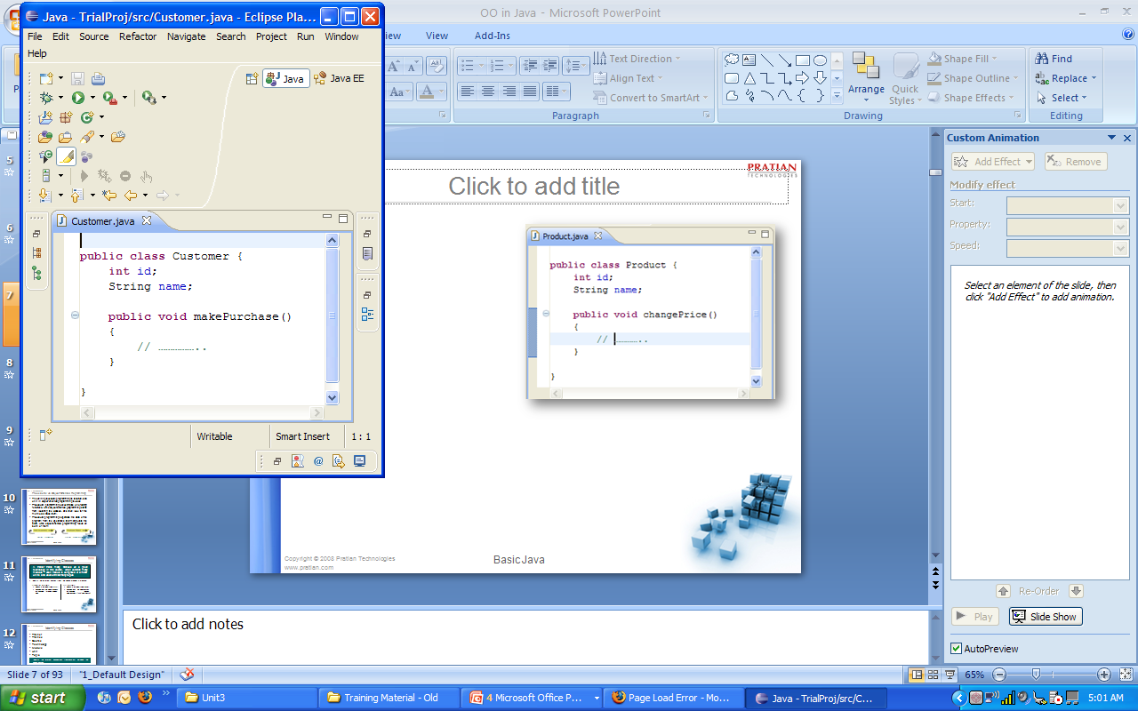
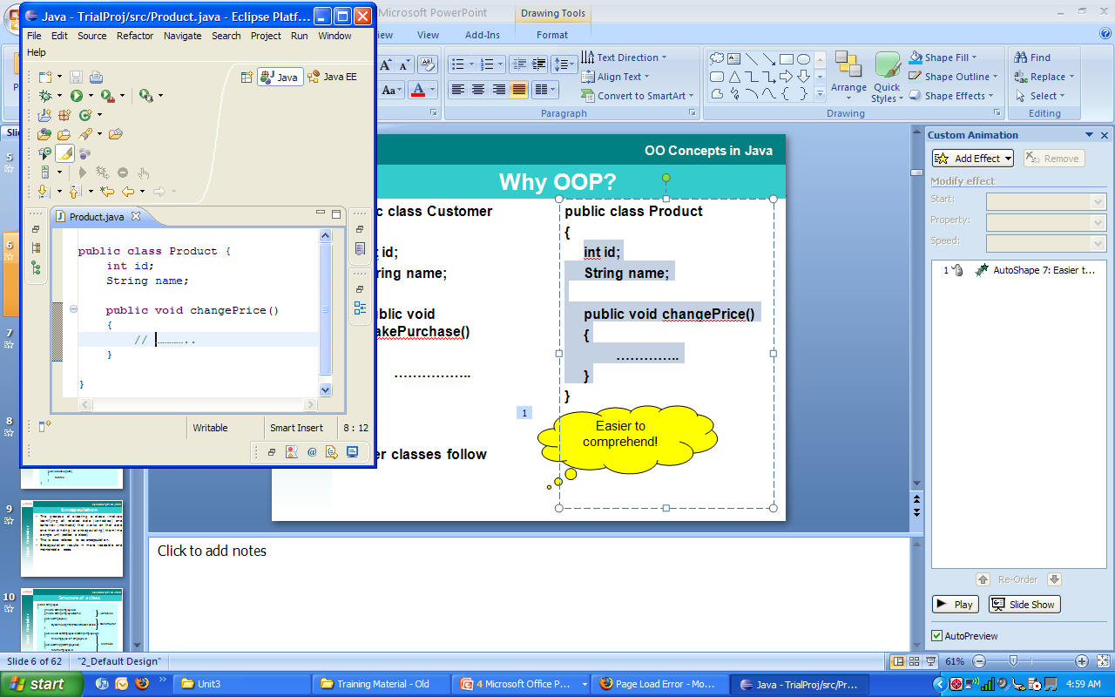
Why choose the OO approach ?
Easier to
comprehend

Slide 8
Why choose the OO approach?
The OO approach
  Deals with classes as the building blocks
  Allows Real World Modeling
  The idea of OOP is to try to approach programming in a more natural way by grouping all the code that belongs to a particular object—such as an account or a customer — together
Project
ProjLead
*
*
*
*
*
*
*
*
ProjMgr
1
1
1
1
Raise the level of abstraction
  Applications can be implemented in the same terms in which they are described by users
Easier to find nouns and construct a system centered around the nouns than actions in isolation
Employee
Manager
Salesperson
1
*
Easier to visualize an encapsulated representation of data and responsibilities of entities present in the domain
The modern methodologies recommend the object-oriented approach even for applications developed in C or Cobol

Slide 9

Object-Oriented Programming
“Object-oriented programming is a
method of implementation in which
programs are organized as
cooperative collections of objects,
each of which represents an instance
of some class...” Grady Booch
Notes:
Language Fundamentals
© Pratian Technologies (India) Pvt. Ltd.
2.<number>

Slide 10


Procedural vs. Object-Oriented Programming
The unit in procedural programming is function, and unit in object-oriented programming is class
Procedural programming concentrates on creating functions, while object-oriented programming starts from isolating the classes, and then look for the methods inside them.
Procedural programming separates the data of the program from the operations that manipulate the data, while object-oriented programming focus on both of them
figure1: procedural figure2: object-oriented
Notes:
Language Fundamentals
© Pratian Technologies (India) Pvt. Ltd.
2.<number>

Slide 11









What is a Class?
  A class gives a generic notion of what objects look like
An employee
Joe
Instantiate (create)
Employee
Class
An object is an instance of a class
  Classes are used to distinguish one type of object from another
Reg. Customer
Employee
Types
Customer

Slide 12






Class
User defined type
  Encapsulates all the data and operations pertaining to an entity
  Provides a Single representation to all the attributes defining the entity
  Passing single representations is easier
Employee
empId : String
name : String
address : Address
getEmpID() : String
setEmpId(empId : String)
getName() : String
setName(name : String)
getAddress() : Address
setAddress(address : Address)
Data types as collections
  A struct in C encapsulates only data. Used as a data structure to store different types of data
  An array is used to store different elements of the same type

Slide 13
Relationship between Classes
Classification
  <<Is-a>>
  Generalization
  Realization
  <<Has-a>>
  Association
  Aggregation
  Composition
  <<Uses>>
  Dependency
For all practical purposes we will represent
    Is-a relationship as
    Has-a relationship as
    Uses relationship as

Slide 14
Has-a Relationship
The ‘Has-a’ relationships are qualified by
  Multiplicity
    The number of instances with which a class is associated
    Can be 1, 0..1, *, 1..*, 0..*, 2..*, 5..10, etc.
    Multiplicity is by default 1
  Navigability
    Can be unidirectional or bidirectional
    Navigability is by default bi-directional
  Role name
    The name of the instance in the relationship
    Multiple ‘has-a’ based on different roles are possible
Employee
-curr
1
-prev
1
Employment
0..*
0..*

Slide 15
Identifying Classes
A trainer trains many trainees on a given technology in this course, which contains many modules – each module is comprised of different units and each unit has many topics.
Identify the different classes from the above problem statement
Procedural approach
  Focus is on identifying VERBS
  Connections between functions established through Function Calls
OO approach
  Focus is on identifying NOUNS
  Connections between classes established through Relationships (‘Is-a’ and ‘Has-a’)
Notes:
Language Fundamentals
© Pratian Technologies (India) Pvt. Ltd.
2.<number>

Slide 16
Identifying Classes
Trainer
Trainee
Course
Technology
Module
Unit
Topic
Identify the different connections (relationships) between the above classes
Notes:
Language Fundamentals
© Pratian Technologies (India) Pvt. Ltd.
2.<number>

Slide 17
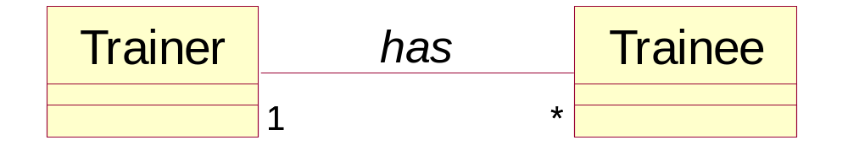
Identifying Relationships
Trainer - Trainee
  Trainer ‘HAS’ many Trainees
  Every Trainee ‘HAS’ a Trainer
Notes:
Language Fundamentals
© Pratian Technologies (India) Pvt. Ltd.
2.<number>

Slide 18
Identifying Relationships
Course – Technology
Course - Module
  Course ‘HAS’ an associated Technology
  A Technology has many courses
  Course ‘HAS’ many Modules
has
Course
*
1
Technology
has
*
*
Module
Notes:
Language Fundamentals
© Pratian Technologies (India) Pvt. Ltd.
2.<number>

Slide 19
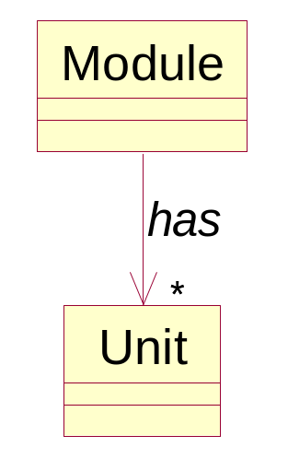
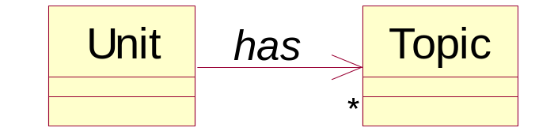
Identifying Relationships
Module – Unit
  Module ‘HAS’ many Units
Unit – Topic
  Unit ‘HAS’ many Topics
Notes:
Language Fundamentals
© Pratian Technologies (India) Pvt. Ltd.
2.<number>

Slide 20
The OO Model
Trainer
has
Trainee
1
1
*
*
Course
*
has
1
Technology
has
*
*
Module
has
*
*
Unit
has
Topic
*
*
How do you relate the Trainer & Trainee to the Course?
Notes:
Language Fundamentals
© Pratian Technologies (India) Pvt. Ltd.
2.<number>

Slide 21
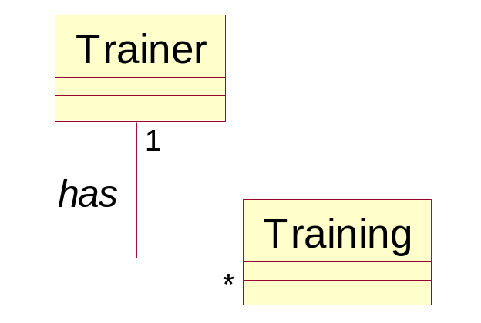
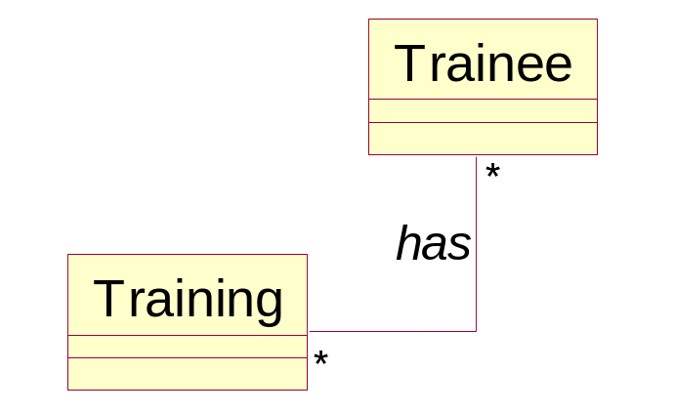
Conceptual Entity
Trainer – Training
  A Trainer (HAS) conducts many Trainings
  A Training HAS a Trainer
Trainee – Training
  A Trainee (HAS) attends many Trainings
  A Training HAS a many Trainees
Notes:
Language Fundamentals
© Pratian Technologies (India) Pvt. Ltd.
2.<number>

Slide 22
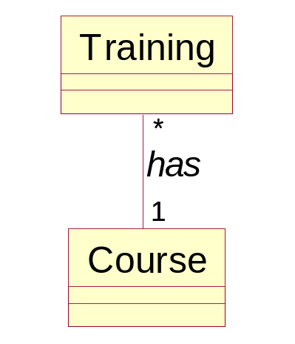
Conceptual Entity
Training - Course
  The Training (HAS) an association with a Course (conducted for a Course)
  A Course HAS many Trainings
Notes:
Language Fundamentals
© Pratian Technologies (India) Pvt. Ltd.
2.<number>

Slide 23
Solution
Trainer
has
Trainee
1
1
*
*
*
1
*
1
has
has
Training
It is not necessary to always have a CONCEPTUAL ENTITY in a Design
*
*
*
*
*
*
has
1
1
Module
has
Course
has
1
Technology
*
*
*
*
has
*
Unit
has
Topic
*
*
Easier to model real-world problems through the OO approach than through the procedural approach
Notes:
Language Fundamentals
© Pratian Technologies (India) Pvt. Ltd.
2.<number>

Slide 24
Exercise
A company sells different items to customers who have placed orders. An order can be placed for several items. However, a company gives special discounts to its registered customers.
Identify the different classes from the above problem statement
Identify the different connections (relationships) between the above classes
Notes:
Language Fundamentals
© Pratian Technologies (India) Pvt. Ltd.
2.<number>

Slide 25
Identifying Classes
Company
Item
Order
Customer
RegCustomer
Notes:
Language Fundamentals
© Pratian Technologies (India) Pvt. Ltd.
2.<number>

Slide 26
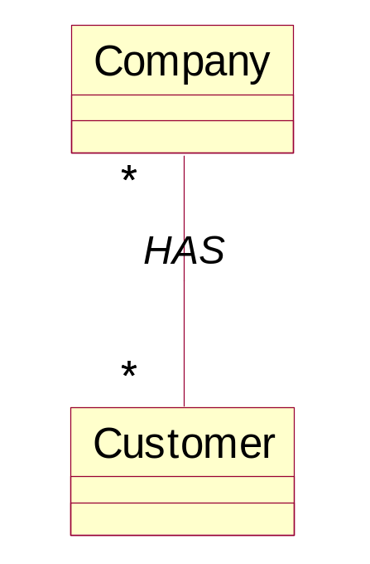
Identifying Relationships
Company - Customer
  Company ‘HAS’ many Customers
  Customer ‘HAS’ many Companies
Notes:
Language Fundamentals
© Pratian Technologies (India) Pvt. Ltd.
2.<number>

Slide 27
Identifying Relationships
Company - Item
  Company HAS many Items
Company
HAS
Item
*
*
Notes:
Language Fundamentals
© Pratian Technologies (India) Pvt. Ltd.
2.<number>

Slide 28
Identifying Relationships
Customer - RegCustomer
  RegCustomer ‘IS’ a Customer
Customer
IS a
RegCustomer
discount
Notes:
Language Fundamentals
© Pratian Technologies (India) Pvt. Ltd.
2.<number>

Slide 29
Identifying Relationships
Order - Item
  Order HAS many Items
Order
HAS
Item
*
*
Notes:
Language Fundamentals
© Pratian Technologies (India) Pvt. Ltd.
2.<number>

Slide 30
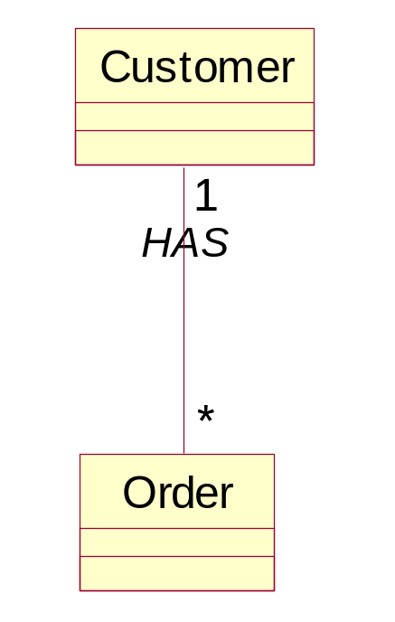
Identifying Relationships
Customer - Order
  Customer HAS many Orders
  Order HAS one Customer
Notes:
Language Fundamentals
© Pratian Technologies (India) Pvt. Ltd.
2.<number>

Slide 31
The OO Model
Company
A Customer can place many orders implies that RegCustomer can also place many Orders.
A Company has many Customers implies that a Company also has many RegCustomers
*
*
HAS
*
*
Customer
IS a
RegCustomer
discount
1
1
HAS
*
*
Order
HAS
Item
*
*
*
*
Notes:
Language Fundamentals
© Pratian Technologies (India) Pvt. Ltd.
2.<number>

Slide 32
Class in Java
A class is a software construct that defines the instance variables and methods of an object.
A class is a template that defines how an object will look and behave when the object is created or instantiated from the specification declared by the class.
A class can be viewed as a user defined data type.
class Point
{
double x;
double y;
double getX()
{
return x;
}
}
Notes:
Language Fundamentals
© Pratian Technologies (India) Pvt. Ltd.
2.<number>
Class
A class is a software construct that defines the instance variables and methods of an object. A class in and of itself is not an object. A class is a template that defines how an object will look and behave when the object is created or instantiated from the specification declared by the class. We obtain concrete objects by instantiating a previously defined class. We can instantiate many objects from one class definition, just as we can construct many houses that area all the same from a single architect's drawing. Here's the basic declaration of a very simple class called Point:
class Point extends Object {
public double x; /* instance variable */
public double y; /* instance variable */
}
This declaration merely defines a template from which real objects can be instantiated, as described next.
Having declared the size and shape of the Point class above, any other object can now create a Point object -- an instance of the Point class -- with a fragment of code like this:
Point myPoint; /* declares a variable to refer to a Point object */
myPoint = new Point(); /* allocates an instance of a Point object */

Slide 33
Structure of a class
class Employee
{
String employeeId;
String employeeName;
Employee()
{
System.out.println(“Constructor called”);
}
void setEmployeeId(String employeeId)
{
this.employeeId = employeeId;
}
String getEmployeeId()
{
return employeeId;
}
}
Instance Variables
Constructor
Methods

Slide 34
What is an Object?
An object is an entity with a well-defined State and Behavior
An object is created from the class
definition using the new operator.
The state of an object is referred to as
the values held inside the instance
variables of the class.
The behavior of the class is referred
to as the methods of the class.
To create an object of the class Point,
say,
Point p = new Point();
When an object of the class is created, memory is allocated for
all the instance variables, here p is not an object but a reference or handle to an object being created.
class Point
{
double x;
double y;
double getX()
{
return x;
}
}
Notes:
Language Fundamentals
© Pratian Technologies (India) Pvt. Ltd.
2.<number>
Now, we can access the variables of this Point object by referring to the names of the variables, qualified with the name of the object:
myPoint.x = 10.0;
myPoint.y = 25.7;
This referencing scheme, similar to a C structure reference, works because the instance variables of Point were declared public in the class declaration. Had the instance variables not been declared public, objects outside of the package within which Point was declared could not access its instance variables in this direct manner. The Point class declaration would then need to provide accessor methods to set and get its variables.
Method
A method is a function or procedure which is defined in a class and typically can access the internal state of an object of that class to perform some operation. It can be thought of as a procedure with the first parameter as the object to work on.

Slide 35
Instantiating Classes
public class Shop
{
public static void main(String[] args)
{
Product p1=new Product();
p1.id=1;
p1.name="Steam Iron";
Product p2=new Product();
p2.id=2;
p2.name="Microwave"
p1.makePurchase();
................
}
}
P1 is a reference
The RHS creates an instance

Slide 36
Exercise
Create a class Employee with the following data members and methods
  Data
    empID : string
    empName : string
  Methods
    Set methods and get methods for the data members
Write a class EmployeeData with two methods
  storeData() which takes the Employee object as an argument and returns the same
    Accepts user input for employee data and sets the data on the object
  showData() which takes an Employee object as argument and displays the data from the object
Write a class EmployeeDemo with the main method
  Create an instance of the Employee object and pass the same to the storeData() and showData()

Slide 37
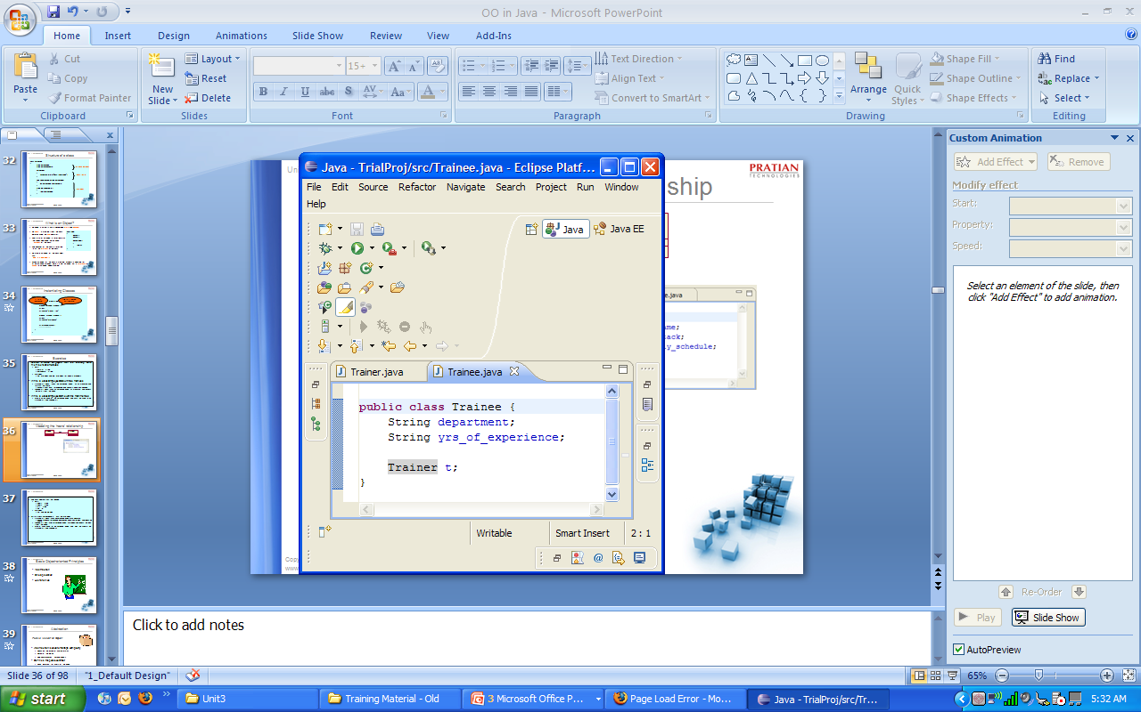
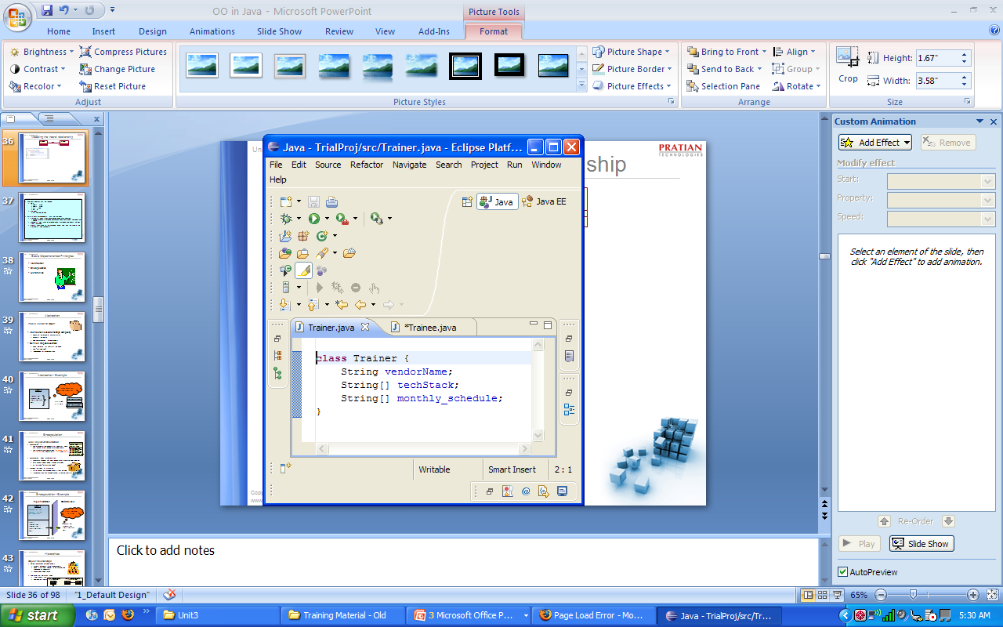
Modeling the ‘has-a’ relationship
Trainee
has
Trainer
1

Slide 38
Exercise
Write a class Address with the following data members and methods
  Data
    addr1 : string
    addr2 : string
    city : string
    pin : int
  Methods
    set and get methods
The relationship between Employee class and Address class is
  EMPLOYEE has ADDRESS
  Model the relationship
Modify the storeData methods of EmployeeDate class to also accept and include Address details

Slide 39
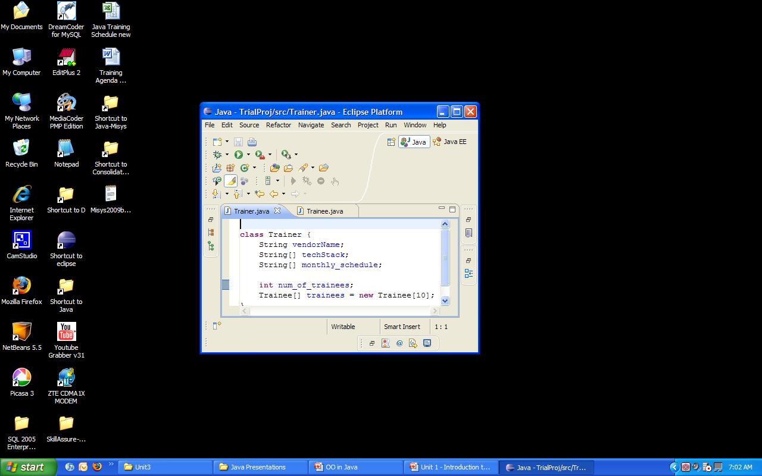
Modeling ‘has-a’ with multiplicity ‘n’

Slide 40


References v/s Objects
public class Shop
{
public static void main(String[] args)
{
Product p1=new Product();
p1.id=1;
p1.name="Steam Iron";
Product p2=p1;
p2.id=2;
p2.name="Microwave“;
}
}
How many objects & references?

Slide 41


References v/s Objects
class Person {
private String name;
private int age;
Person(String n, int a) {
name = n; age = a;
}
public void printPerson() {
System.out.println("Hi, my name is " + name);
System.out.println(". I am " + age + " years old.");
}
public static void main (String args[]) {
Person p1;
p1 = new Person("Luke", 50);
p1.printPerson();
p1 = new Person("Laura", 35);
p1.printPerson();
}
}
How many objects & references ?
Notes:
Language Fundamentals
© Pratian Technologies (India) Pvt. Ltd.
2.<number>
What does the example do?
The Person class has a Constructor that takes a String and an integer as parameters.
It has a printPerson and a main method.
In the main method, an object of Person class is created and the name and age are initialised in the constructor. The printPerson is then called to print the initialised values.
The output of the program would be
Hi, my name is Luke. I am 50 years old.
----
Hi, my name is Laura. I am 35 years old.
----

Slide 42

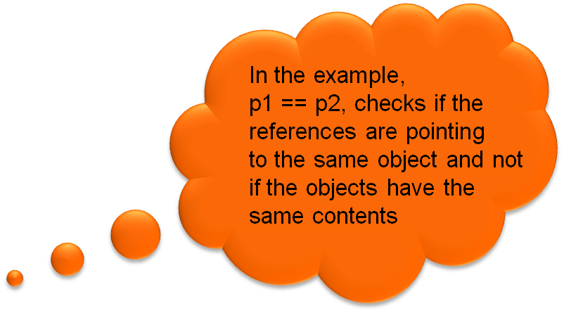
Comparing Objects
class Point
{
private double x;
private double y;
public Point(int _x , int _y){
x = _x;
y = -y;
}
public double getX()
{
return x;
}
public static void main(String[] args)
{
Point p1 = new Point(10, 20);
Point p2 = new Point(10, 20);
if(p1 == p2)
System.out.println(“The two objects have the same content”);
else
System.out.println(“The two objects have different content”);
}
}

Slide 43
Comparing Objects
The ‘==‘ operator when used with objects, does not compare the states of the objects.
Instead it compares whether the two references point to same object in memory or not.
It is simply because the compiler does not know how to compare user defined types, Eg., how can the compiler know how to compare 2 customers (i.e., objects of Customer class)
To do more meaningful comparison, the equals method is used.
    The programmer is responsible for providing this method for his classes

Slide 44
Initialising Objects
All data members in a class can be initialised at the point of declaration in a class.
If the primitive types are not initialised they are default set to 0 for numeric, set to ‘ ‘(whitespace) for char and set to false for boolean data type.
Similarly a reference type can be initialised at the point of declaration in a class, if not they are set to null.
Data members are initialised before any method or constructor is called.
What is a constructor?
See listing : InitialisationDemo.java
Notes:
Language Fundamentals
© Pratian Technologies (India) Pvt. Ltd.
2.<number>

Slide 45

Constructor
Constructor is a special method with the same name as that of the class.
Constructors are called implicitly at the time of object creation.
Constructors do not have a return type.
Every class has at least one constructor.
  Either defined by programmer or the compiler provides a default constructor.
class Product
{
Product()
{
//instantiate the variables
……………..
………………
}
}

Slide 46


Why Constructors?
public class Shop
{
public static void main(String[] args)
{
Product p1 = new Product();
p1.id = 1;
p1.name = "Steam Iron";
p1.price = 100;
p1.category = "luxury";
if (p1.price > 99 && p1.category.equals("luxury"))
p1.tax=p1.price*0.20;
else
p1.tax=p1.price*0.10;
}
}
Here, the tax is calculated based on the price and category. What if the programmer forgets to calculate tax?

Slide 47

Why Constructors?
class Product
{
int productId;
String productName,category;
float price,tax;
Product(int id , String name ,
String cat , float p)
{
productId = id;
productName = name;
category = cat;
price = p;
if (price>99 && category.equals("luxury"))
tax = price*0.20;
else
tax = price*0.10;
}
}
public static void main(String[] args){
Product p1 = new Product(1,”Steam Iron”,”luxury”,100);
p1.makePurchase();
}

Slide 48




Compiler and Constructors
class Product
{
int id;
String name;
public void changePrice()
{
…………..
}
}
public class Product
{
int id;
String name;
public Product(int id){
………..
}
public void changePrice()
{
…………..
}
}
No constructor defined by the programmer. The compiler adds the public no-args constructor
A constructor defined by programmer. Compiler does not add anything

Slide 49
Exercise
Write a class Rectangle with data members, double length and double breadth. Write a parameterized constructor which takes length and breadth as parameters and assigns them to the instance variables. Write a method area() which calculates the area and returns the same.
Write a class InterestCalculator with data members, double principle , int time , double intRate. Write a parameterized constructor which takes principle and time. The intRate has to be calculated in the constructor based on the time, if time is >= 5 the rate is 10% else 12%. Write a method getInterest() which calculates the simple interest and returns the same. Test the code.

Slide 50

Basic Object-oriented Principles
Abstraction and Encapsulation
To truly appreciate many concepts
of OOP, it is important to distinguish
between creators of the class and
users of the class.
Class users are also programmers who are creating their program using the classes provided by the class creators
Often, the creators of the class are not the users of the class. Eg., there are tons of classes in Java’s built-in libraries authored by creators of the language but are used by us.
Notes:
Language Fundamentals
© Pratian Technologies (India) Pvt. Ltd.
2.<number>

Slide 51

Abstraction
Public View of an Object
Abstraction is used to manage complexity
  Focus on the essential characteristics
  Eliminate the details
  Find commonalities among objects
Defines the public contract
  Public definition for users of the object
  The “Outside view”
  Independent of implementation
Notes:
Language Fundamentals
© Pratian Technologies (India) Pvt. Ltd.
2.<number>

Slide 52
Abstraction - Example
“What should an Order object do?”
Order
CreateOrder
UpdateOrder
GetOrderTotal
Next
InternalOrder
Two types of Orders
ExternalOrder
Notes:
Language Fundamentals
© Pratian Technologies (India) Pvt. Ltd.
2.<number>

Slide 53

Encapsulation
Hide Implementation Details
Encapsulation is
  The grouping of related ideas into a single unit, which can thereafter be referred to by a single name.
  The process of compartmentalizing ‘the elements of an abstraction’ that constitute its structure and behavior.
Employee
empId : String
name : String
address : Address
getEmpID() : String
setEmpId(empId : String)
getName() : String
setName(name : String)
getAddress() : Address
setAddress(address : Address)
Encapsulation hides implementation
  Promotes modular software design – data and methods together
  Data access always done through methods
  Often called “information hiding”
Provides two kinds of protection:
  State cannot be changed directly from outside
  Implementation can change without affecting users of the object
Notes:
Language Fundamentals
© Pratian Technologies (India) Pvt. Ltd.
2.<number>

Slide 54
Encapsulation - Example
Implementation Outside View
Order
Public methods of Order
orderNum AS INT
custNum AS INT
CalculatePrice( )
PUBLIC:
CreateOrder( )
UpdateOrder( )
GetOrderTotal( )
Next( )
CreateOrder
UpdateOrder
GetOrderTotal
Next
Notes:
Language Fundamentals
© Pratian Technologies (India) Pvt. Ltd.
2.<number>

Slide 55
Encapsulation - Example continued
Hmm... I’d like to change CalculatePrice to CalculateTotalPrice
Order
orderNum AS INT
custNum AS INT
CalculatePrice( )
PUBLIC:
CreateOrder( )
UpdateOrder( )
GetOrderTotal( )
Next( )
GetOrderTotal calls CalculatePrice( )

Slide 56
Encapsulation - Example continued
Order
This change was easy because users of the object will not be affected.
orderNum AS INT
custNum AS INT
CalculateTotalPrice( )
PUBLIC:
CreateOrder( )
UpdateOrder( )
GetOrderTotal( )
Next( )
GetOrderTotal now calls CalculateTotalPrice( )

Slide 57
Implementing Abstraction and Encapsulation
class Order
{
int orderNum;
int custNum;
double calculateTotalPrice(){..........}
void createOrder() { ........... }
void updateOrder() {...............}
double getOrderTotal() { ………. }
Order next() { ………… }
}
Invisible
Visible
What should be exposed to the class user?

Slide 58
Access Specifiers
Access modifiers are those which control access to methods and variables. public , private, protected and default
public
  Any class member declared as public is visible (or accessible) to the whole world (meaning any class)
private
  Any class member declared as private is visible (or accessible) only inside the same class
protected (More on this later)
  Any class member declared as protected is visible (or accessible) to all classes in the same package as well as to sub classes (regardless of the package)
default (More on this later)
  Any class member declared without any of the above is visible (or accessible) to all classes in the same package only.

Slide 59
Specifying Access
class Order
{
private int orderNum;
private int custNum;
private double calculateTotalPrice(){..........}
public void createOrder() { ........... }
public void updateOrder() {...............}
public double getOrderTotal() { ………. }
public Order next() { ………… }
}

Slide 60
Exercise
Let us say we have to design a class Car to represent the automobile in our domain.
Assume some requirements and realize the abstractions and encapsulations of the car.
Apply access specifiers to provide the right abstraction to the users of the class

Slide 61
Implementing Abstraction & Encapsulation
public class Car
{
private Engine e;
private FuelTank tank;
private void pullFuelFromTank(){..........}
private void regulateEngineTemperature(){.........}
public void start()
{
...........
}
public void stop()
{
...............
}
}

Slide 62

If you are wondering…
If you are wondering what’s the difference between Abstraction and encapsulation
Encapsulation deals with ‘what goes into’ a class
Abstraction deals with ‘what is made visible’ to the class user.

Slide 63

Static Members
Methods and variables of a class can be marked as Static
Static members are not tied to any instance of the class, rather they are termed as the class members.
The static members of the class can be accessed directly without creating an instance of the class.
Static methods cannot access non-static members.
But non-static members can access static members.
public class Product
{
int id;
String name;
static int count;
public Product(int id ,
String name)
{
this.id = id;
this.name = name;
++count;
}
public static int getCount(){
return count;
}
}
See listing : StaticMembersDemo.java

Slide 64

Static Methods - Example
class Factorial {
public static void main(String[] args) {
int input = Integer.parseInt(args[0]);
double result = calculateFactorial(input);
System.out.println("Factorial of "+input+
"is: "+(int)result);
}
public static double calculateFactorial(int x) {
if (x < 0)
return 0;
double fact = 1;
while (x > 1) {
fact = fact * x;
x = x - 1;
}
return fact;
}
}

Slide 65

Static Initialization
Static data members can be initialized inside a static construction clause(static block) and it happens only once when the class is loaded in memory.
public class BillingSys
{
Product[ ] productList;
static int taxRate;
static
{
taxRate = open a configuration file and
read from the file
}
public static int getTaxRate(){
return taxRate;
}
}

Slide 66
Inheritance
An object oriented system organizes classes into a subclass-super class hierarchy
  Inheritance encourages ‘code reuse’
Each subclass reuses the implementations in the base class
  Can add new responsibilities
Generalization
Mary
Employee
Specialization
Manager
Salesperson
David
Joe

Slide 67
Why Inheritance?
public class Car
{
Engine e;
FuelTank tank;
void pullFuelFromTank()
void regulateEngTemp()
void start()
void stop()
switchOnAC()
}
public class Truck
{
Engine e;
FuelTank tank;
void pullFuelFromTank()
void regulateEngTemp()
void start()
void stop()
loadGoods()
unloadGoods()
}
Redundant!!

Slide 68



Inheritance for Reuse
public class Vehicle
{
Engine e;
FuelTank tank;
void pullFuelFromTank()
void regulateEngineTemperature()
void start()
void stop()
}
public class Car extends Vehicle
{
switchOnAC()
}
public class Truck extends Vehicle
{
loadGoods()
unloadGoods()
}

Slide 69
Inheritance and Access Specification
Should not be visible to class users but should be visible to subclasses
public class Vehicle
{
Engine e;
FuelTank tank;
void pullFuelFromTank(){..........}
void regulateEngineTemperature(){.........}
void start(){...........}
void stop(){...............}
}
How would you achieve it?
Should be visible to everyone

Slide 70
Inheritance and Access Specification
public class Vehicle
{
protected Engine e;
protected FuelTank tank;
protected void pullFuelFromTank()
protected void regulateEngineTemp()
public void start()
public void stop()
}
Should not be visible to class users but should be visible to subclasses
` ``` ````
Should be visible to everyone

Slide 71
Object Class
Class Object is the root of the class hierarchy in Java.
All objects either directly or indirectly inherit from this class.
Some important methods of the class
  protected Object clone()
  public boolean equals(Object obj)
  protected void finalize()
  public String toString()
  public void notify()
  public void wait()

Slide 72
Constructor Chaining
Every constructor method calls its base class constructor directly using super() or indirectly using this().
If the first statement of a constructor does not explicitly call this() or super(), the compiler adds the call to the default super constructor
  If super class does not have a default constructor, compiler will throw an error
So, always , whenever any object is created, the very first constructor to fully get executed is of java.lang.Object
See listing : ConstructorChaining.java

Slide 73
Exercise
Write a class Customer with the following data members,
  String : custId
  String : name
  Address : address
Write a parameterized constructor which takes custId , name and address as input and assigns the same to the instance variables and write getter methods for all the instance variables.
Write a class Address with the following data members,
  String : addr1
  String : addr2
  String : city
  int : pin
Write the respective setter and getter methods.
Write a class RegCustomer which extends from the class Customer and has the instance variable
double : fees.
Write a appropriate parameterized constructor and call the base class constructor.
In the main create an instance of the class RegCustomer by passing the values and display the same.

Slide 74
Type Casting of Primitives
A primitive of one data type can be cast to other type in Java.
  Casting is possible if the the two types are compatible.
    All numeric types are compatible with each other.
    Integers are compatible with characters.
    Boolean is not compatible with any of the data type.
  Casting is implicit if destination type is larger than source type.
    Eg : int to double;
    int to long, short to int.
  Casting needs to be explicit if the destination type is smaller than source type.This may lead to loss of data.
    Eg : double to int;
      long to int;
See listing : PrimitiveTypeCast.java

Slide 75
Type Casting of Objects
Objects can be typecast only if they are related by inheritance not otherwise.
A derived class object can be automatically typecast to a base class reference.
  eg
  Employee emp = new Manger();//implicit
  Manager mgr = new Manager();
  mgr = (Manager) emp; // works //explicit
  emp = mgr; // works

Slide 76
Comparing Objects
The ‘==‘ operator when used with objects, does not compare the states of the objects.
This logic of comparing two objects of a class is best known to the author of the class
To do more meaningful comparison, the equals method is used.
    The programmer is responsible for providing this method for his classes

Slide 77

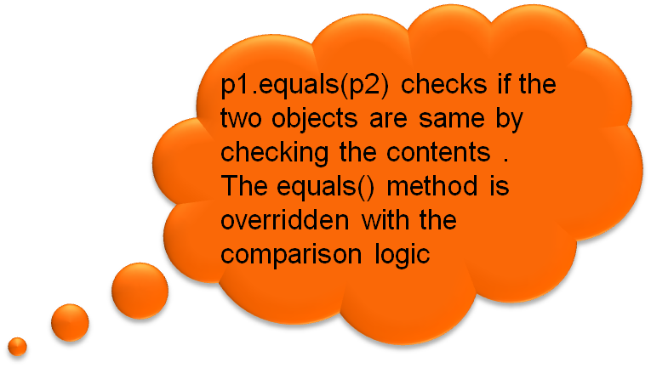
Comparing Objects
class Point {
private double x , y;
public Point(int _x , int _y){
x = _x;
y = -y;
}
public boolean equals(Object o) {
Point p = (Point) o;
if(p.x == x && p.y == y)
return true;
else
return false;
}
public static void main(String[] args) {
Point p1 = new Point(10,20);
Point p2 = new Point(30,20);
if(p1.equals(p2))
System.out.println(“Objects are duplicates, with the same contents”);
else
System.out.println(“Objects have different contents”);
}
}

Slide 78
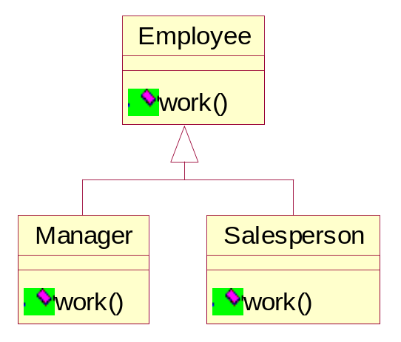
Polymorphism
One function, many implementations
All employees do some work
Mary
David
Joe
David does a manager’s work
Joe does a salesperson’s work
Early binding
  Function Call mapped at compilation
  Function Overloading
Late binding
  Function Call mapped at run-time
  Function Overriding
Runtime Polymorphism (late binding) has three requirements:
  Hierarchy with overridden method in derived class
  Base class reference used to call method
  Derived class assigned to base class reference

Slide 79
Polymorphism
Two types of polymorphism
  Static polymorphism
    Method overloading
    Input data (parameter) determines the type of method to be called
  Dynamic polymorphism
    Method Overriding
    Type of object pointed by an interface or a super class variable determines the specific action
Notes:
Language Fundamentals
© Pratian Technologies (India) Pvt. Ltd.
2.<number>
Polymorphism
Polymorphism is the ability of an object to assume or become many different forms of object. Inheritance specifies slightly different or additional structure or behavior for an object, and these more specific or additional attributes of an object of a base class (or type) when assuming or becoming an object of a derived class characterizes object-oriented polymorphism

Slide 80

Method Overloading
Overloading is achieved by having multiple methods with the same name but with different parameters.
Multiple methods with the same name differ based on the parameters.
It is easier for the class users to remember fewer number of method names
Methods cannot be overloaded based on the return type.
public class Addition
{
public int add(double x , double y)
{
return x + y;
}
public int add(int x , int y)
{
return x + y;
}
}
See listing : OverLoadingDemo.java

Slide 81

Overloaded Constructor
class Employee {
String empId,empName;
double salary;
//overloaded constructor
Employee() {}
Employee(String id,String name,double sal)
{
empId = id; empName = name; salary = sal;
}
public static void main(String ars[])
{
Employee e1 = new Employee();
Employee e2= new Employee (“951002”,”Sam”,23480);
}
}

Slide 82
Method Overriding
Vehicle
start()
stop()
Bike
start()
stop()
Car
start()
stop()
Bus
start()
stop()
See listing : OverridingDemo1.java

Slide 83
Method Overriding
Redefine the method in the subclasses with the same signature as a method in the superclass
Used when the behaviour of the child class is different from that of the base class
Method in sub class overrides the method in the superclass
Methods cannot be overridden to be more private, only to be more public
See listing : OverridingDemo2.java
Notes:
Language Fundamentals
© Pratian Technologies (India) Pvt. Ltd.
2.<number>

Slide 84
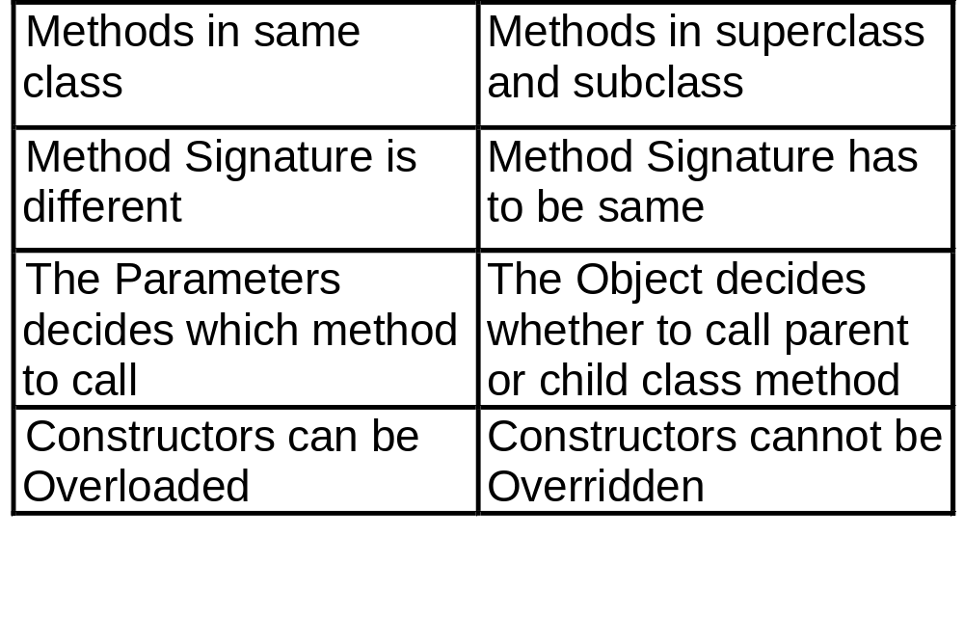
Overloading v/s Overriding
Notes:
Language Fundamentals
© Pratian Technologies (India) Pvt. Ltd.
2.<number>

Slide 85
Exercise
Write a class Addition, which has a method add() overloaded to add two Strings, ints, double and test the code.
Write a class Person with data members
  String name
  int age
  char sex
  and write appropriate setter and getter methods.
  Write the equals() method to check for equality
  Create two instances of the Person class and pass
  the data. Check if the two person instances are
  same by using the equals() method and display the
  same.

Slide 86
Final Modifier
The final modifier is used with variables, methods and classes to indicate they cannot be changed.
The value of a data member marked as final cannot be changed after initialization
Methods marked as final cannot be overridden in its child class.
Classes marked as final cannot be sub classed.

Slide 87

Inner Classes
Java allows a class to be defined within another class, such a class is called a inner class.
Inner classes have access to variables and methods of the enclosing class.
As a member of outerclass, a inner class can be declared with public, private, protected static or default access specifiers/modifiers.
public class OuterClass
{
…………….
…………….
class InnerClass
{
………..
………..
}
}
Notes:
Language Fundamentals
© Pratian Technologies (India) Pvt. Ltd.
2.<number>

Slide 88
Why use Inner Classes?
Logical grouping of classes – If a class is useful to only one other class, then it is logical to embed it in that class and keep the two together. Nesting such helper classes makes the package more streamlined.
Increased encapsulation – Consider two classes A and B, here B a helper class needs access to private members of class A. Here B can be nested inside class A, thereby access the private members of A and B is hidden from outside world.
More readable, maintainable code – Nesting small classes within top-level classes places the code closer to where its used, thereby its better readable and maintainable.
To substitute Multiple Inheritance – Multiple inheritance is disallowed in Java. If a class has to derive properties from more than one class, it can have a inner class which can extend from another class.

Slide 89

Instance of an Inner class
Similar to instance methods and variables, an inner class is associated with an instance of the outer class.
Since inner class is associated with an instance, it cannot define any static members itself.
An instance of the inner class can exist only in the context of an instance of the outer class and has direct access to methods and fields of its enclosing instance.
To instantiate an inner class, first the outer class should be instantiated and then the inner class object is created within the outer object.
public class OuterClass
{
class InnerClass { }
public static void main(String[ ] arg)
{
OuterClass outer = new OuterClass();
OuterClass.InnerClass inner =
outer.new InnerClass();
}
}

Slide 90


Example of Inner class
class OuterClass {
private int outer_x = 100;
void test(){
InnerClass inner=new InnerClass();
inner.display();
}
class InnerClass {
int inner_y = 10; // y is local to inner
private void display(){
System.out.println("display : outer_x = " +outer_x);
}
}
void show(){
System.out.println(inner_y); //error, y not know here!
}
}
Create an instance of InnerClass to access its members
Notes:
Language Fundamentals
© Pratian Technologies (India) Pvt. Ltd.
2.<number>

Slide 91
Static Inner Class
Similar to a class methods and variables, a static inner class is associated with its outer class.
The static nested class can access the various static members of the enclosing class.
However, unlike non-static inner classes, it cannot access any instance variables in the enclosing class. This is an important difference between static nested classes and non-static inner classes.
Formally, it can be said that an inner class is instance-scoped and a static nested class is class-scoped. The class scope of a static nested class makes it easier to use.

Slide 92


Static Inner Class Example
class OuterClass
{
private int outer_x = 100;
private static int static_x = 200;
class static InnerClass
{
private void display()
{
System.out.println("display : outer_x = " +outer_x);
System.out.println("display : static_x = " +static_x);
}
}
}
Error, cannot access non-static members

Slide 93

Instantiating Static Inner Class
To instantiate a public static nested class, you do not need an instance of the
outer class. You can simply use the class as is to create new instances.
class OuterClass
{
public class static InnerClass
{
public void display()
{
System.out.println(“Inside inner display()”);
}
}
}
Class OuterDemo
{
public static void main(String[ ] args)
{
OuterClass.InnerClass inner = new OuterClass.InnerClass();
inner.display();
}
}

Slide 94
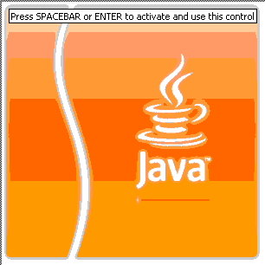

Question time
Please try to limit the questions to the topics discussed during the session. Thank you.
Notes:
Language Fundamentals
© Pratian Technologies (India) Pvt. Ltd.
2.<number>

